Slide 1
SQL INJECTION
Usama Sharfi (IS-036)

Slide 2
AGENDA
What is SQL
What is SQL injection
SQL Injection Types
Prevention of SQL Injection Attack

Slide 3
1
What is SQL?
?
?

Slide 4
SQL (Structured Query Language) is a standardized programming language that's used to manage relational databases and perform various operations on the data in them.

Slide 5
SQL Injection
A class of code-injection attacks, in which data provided by user is included in an SQL query in such a way that part of the user’s input is treated as SQL code.
SQL injection is a technique to maliciously exploit applications that use client-supplied data in SQL statements. Attackers trick the SQL engine into executing unintended commands by supplying specially crafted string input, thereby gaining unauthorized access to a database in order to view or manipulate restricted data.
SQL injection techniques may differ, but they all exploit a single vulnerability in the application: Incorrectly validated or non validated string literals are concatenated into a dynamic SQL statement, and interpreted as code by the SQL engine.
5

Slide 6
2
Types of SQL Attacks

Slide 7
Types of SQL Attacks
In-band: The most popular attack type, in-band SQL injections uses the same communication channel.
Inferential: Commonly referred to as “blind SQL injection attacks”, an actor can send payloads reconstructing the structure of the database.
Out-of-band: The least common of SQL injection attacks, the out-of-band method relies on the database server to make DNS or HTTP requests delivering data to an attacker.

Slide 8
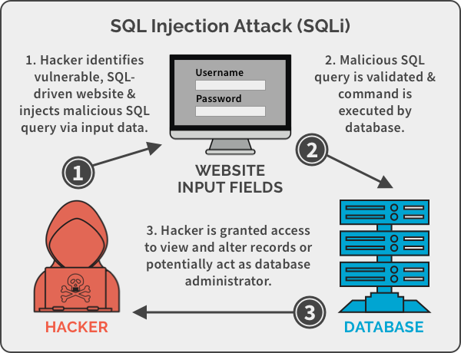
A Big Image

Slide 9
3
Prevention of SQL Injection Attack

Slide 10
Prevention Of SQL Injections
Validate User Inputs
Sanitize Data By Limiting Special Characters
Use Stored Procedures In The Database
Raise Virtual Or Physical Firewalls
Reduce Your Attack Surface
Establish Appropriate Privileges And Strict Access
Limit Read-Access
Encryption: Keep Your Secrets Secret

Slide 11
THANKS!
Any questions?

Slide 12
Demo Site
https://crypto.hackslash.pk/

